Slide 1
Artificial Intelligence
Lecture – 1
Disha Deliwala

Slide 2
AI - Defined
The art and science of bringing learning, adaption and self-organization to the machine is the act of artificial intelligence.

Slide 3
Components of AI
1.Logic
Induction (Knowledge)
Proposition (Reasoning)
Tautology (Control)
Model Logic (Search)
2.Cognition
Temporal Learning (Belief)
Adaptation (Desire)
Self-organization (Intention)
3.Functional
Memory Perception (Utterance)

Slide 4
AI Dimensions
First Dimension
Logic, Cognition and Computation
Second Dimension
Knowledge, Reasoning and Interface
Third Dimension
Information System, Applicability

Slide 5
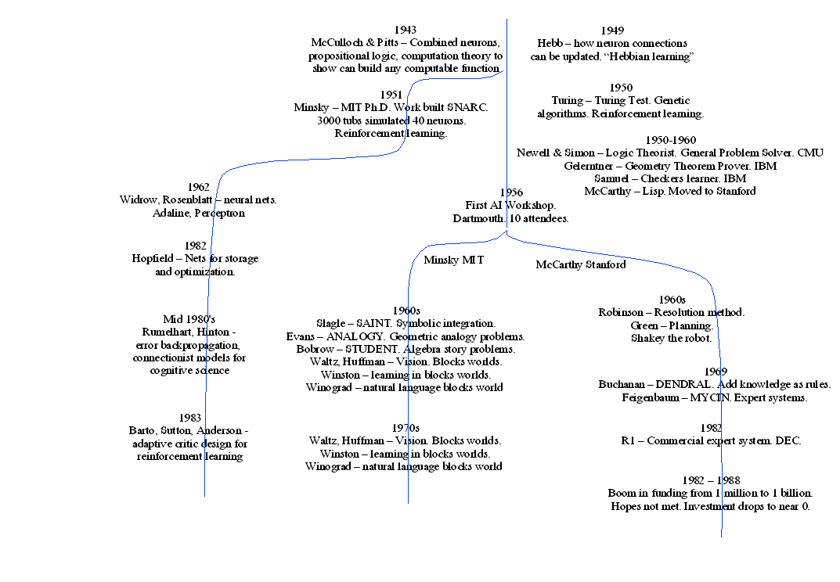
History of AI

Slide 6
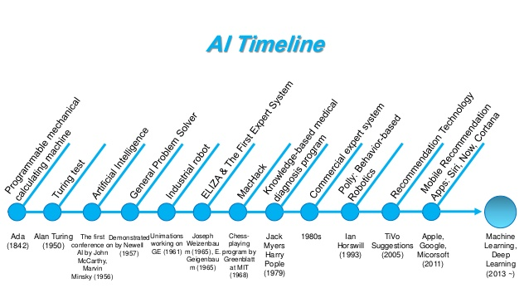
Salient Points in AI Development

Slide 7
Knowledge - Defined
Knowledge combines abstraction and functionalism.
Thinking and Learning are the abstraction of mental activities.
Speech, vision and movement are functional activities.
Information and Knowledge are compound activities made of abstraction and functional activities.

Slide 8
Types of Knowledge
Knowledge in philosophy
Knowledge in science
Knowledge in engineering
ANN – Artificial Neural Network

Slide 9
Knowledge Based Systems(KBS)- Defined
System : It is an interconnection of different entities, atomic in nature to form as a whole in due course of time for a specific goal in mind.
E.g. : car, library
KBS : The basic objective of a knowledge based system is to store facts and figures for a particular application domain in memory , either statically or dynamically.

Slide 10
AI in future
Learning from books
Machine learning
Helpful in diagnosis of errors and suggestive for corrective actions
Distilling from www
Development of complex computational engines such as human mind and brain.

Slide 11
Applications of Artificial Intelligence
Civil Engineering
Computer Engineering
Industrial Automation and Manufacturing (EXPERT PROB / DISPATCHER)
Equipment Maintenance
Management and Finance (EXPERT TAX – corporate tax planning , INGOT – financial forecasting)

Slide 12
Continued
Office Automation – CV FILTER
Robotics
Medical Computability and Informatics
E-Services
Transportation
Agriculture
Oil Exploration, Minerals and Metallurgy
Electrical Engineering

