Slide 1
Knowledge Acquisition

Slide 2
Components of KA
1. Expert
a person who solves complex problems.
May not be aware of knowledge representation.
Expresses his action in his own way of solving problems.

Slide 3
2. Knowledge Engineer
Well acquainted with techniques of computer science.
Interacts with the expert through dialogue or watching his activities.
Get acquainted with the jargon and vernacular of domain as fast as possible.

Slide 4
3. Computing Machine
An inanimate(non-living) entity that can accelerate the computation at a higher rate than human.

Slide 5
Knowledge acquisition process
1. Formulating the concept
Divide the tasks into subtasks
Experts concepts for a particular entity or phenomenon are manifested by KE through analogy.
Eg : medical science

Slide 6
2. Problem implementation
Problem analysis starts from top to bottom and hierarchical.
Two approaches :
Goal – directed decomposition
Forward scenario simulation

Slide 7
3. Knowledge representation
Problem specific
Formal or internal method selected
Predicate logic or rule based selected

Slide 8
Automatic Knowledge Acquisition
1. Function and Automatic KA :
Provides support for entering knowledge to intelligent editors for maintenance of knowledge consistency, knowledge base and knowledge refinement.

Slide 9
2. Intelligent editor
KAS can assist for checking consistency of knowledge that the new knowledge entered in the system is consistent to the existing knowledge.
Helps in detecting redundancy, contradiction or circularity of rule based system.

Slide 10
3. Rule generation and refinement
Rule are generated through learning process.
Rule refinement is requirement when rules are not valid and which display faulty conclusion.
The cause is traced and it leads to correctness.

Slide 11
Machine Learning
Most important phenomenon in AI.
Use knowledge of cognitive science and psychology.
Uses ANN
Learning can be done by induction, analogy, instruction and explaination.

Slide 12
Version space
Concept learning
Uses generalization and specialization
Variables are more generalized than constraints.
Rather than enumerating all of the hypotheses, the subset of H consistent with the examples can be found more efficiently by imposing some structure on the hypothesis space.
Hypothesis h₁ is a more general hypothesis than hypothesis h₂ if h₂ implies h₁.

Slide 13
The hypothesis ¬academic ∧ music is more specific than music and is also more specific than ¬academic.
Thus, music is more general than
¬academic ∧ music.
The most general hypothesis is true. The most specific hypothesis is false.

Slide 14
Induction : ID3
In decision tree learning, ID3 (Iterative Dichotomiser 3) is an algorithm invented by Ross Quinlan used to generate a decision tree from a dataset.
ID3 is typically used in the machine learning and natural language processing domains.

Slide 15
Entropy
In thermodynamics, entropy is a measure of how ordered or disordered a system is.
In information theory, entropy is a measure of how certain or uncertain the value of a random variable is (or will be).
Varying degrees of randomness, depending on the number of possible values and the total size of the set.

Slide 16
Shannon Entropy
Introduced by Claude Shannon in 1948
Quantifies “randomness”
Lower value implies less uncertainty
Higher value implies more uncertainty

Slide 17
Information Gain
Uses Shannon Entropy
IG calculates effective change in entropy after making a decision based on the value of an attribute.
For decision trees, it’s ideal to base decisions on the attribute that provides the largest change in entropy, the attribute with the highest gain.

Slide 18
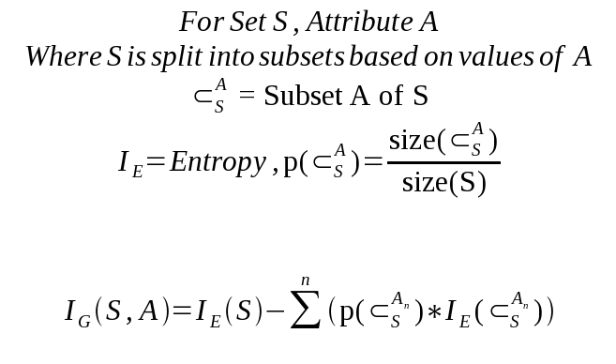
Information Gain

Slide 19
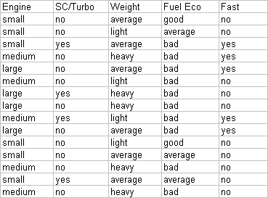
Example
Establish a target classification
Is the car fast?
5/15 yes, 10/15 no

Slide 20
Example – Classification Entropy
Calculating for the Classification Entropy
I_{E}= -(5/15)log₂(5/15)-(10/15)log₂(10/15) = ~0.971
Must calculate Information Gain of remaining attributes to determine the root node.

Slide 21
Example – Information Gain
Engine: 6 small, 5 medium, 4 large
3 values for attribute engine, so we need 3 entropy calculations
small: 5 no, 1 yes | I_{small} = -(5/6)log₂(5/6)-(1/6)log₂(1/6) = ~0.65
medium: 3 no, 2 yes | I_{medium} = -(3/5)log₂(3/5)-(2/5)log₂(2/5) = ~0.97
large: 2 no, 2 yes | I_{large} = 1 (evenly distributed subset)
IG_{Engine} = IE(S) – [(6/15)*I_{small} + (5/15)*I_{medium} + (4/15)*I_{large}]
IG_{Engine} = 0.971 – 0.85 = 0.121

Slide 22
Example – Information Gain
SC/Turbo: 4 yes, 11 no
2 values for attribute SC/Turbo, so we need 2 entropy calculations
yes: 2 yes, 2 no | I_{turbo} = 1 (evenly distributed subset)
no: 3 yes, 8 no | I_{noturbo} = -(3/11)log₂(3/11)-(8/11)log₂(8/11) = ~0.84
IG_{turbo} = IE(S) – [(4/15)*I_{turbo} + (11/15)*I_{noturbo}]
IG_{turbo} = 0.971 – 0.886 = 0.085

Slide 23
Example – Information Gain
Weight: 6 Average, 4 Light, 5 Heavy
3 values for attribute weight, so we need 3 entropy calculations
average: 3 no, 3 yes | I_{average} = 1 (evenly distributed subset)
light: 3 no, 1 yes | I_{light} = -(3/4)log₂(3/4)-(1/4)log₂(1/4) = ~0.81
heavy: 4 no, 1 yes | I_{heavy} = -(4/5)log₂(4/5)-(1/5)log₂(1/5) = ~0.72
IG_{Weight} = IE(S) – [(6/15)*I_{average} + (4/15)*I_{light} + (5/15)*I_{heavy}]
IG_{Weight} = 0.971 – 0.856 = 0.115

Slide 24
Example – Information Gain
Fuel Economy: 2 good, 3 average, 10 bad
3 values for attribute Fuel Eco, so we need 3 entropy calculations
good: 0 yes, 2 no | I_{good} = 0 (no variability)
average: 0 yes, 3 no | I_{average} = 0 (no variability)
bad: 5 yes, 5 no | I_{bad} = 1 (evenly distributed subset)
We can omit calculations for good and average since they always end up not fast.
IG_{FuelEco} = IE(S) – [(10/15)*I_{bad}]
IG_{FuelEco} = 0.971 – 0.667 = 0.304

Slide 25
Example – Choosing the Root Node
Recap:
IG_{Engine} | 0.121
IG_{turbo} | 0.085
IG_{Weight} | 0.115
IG_{FuelEco} | 0.304
Our best pick is Fuel Eco, and we can immediately predict the car is not fast when fuel economy is good or average.

Slide 26
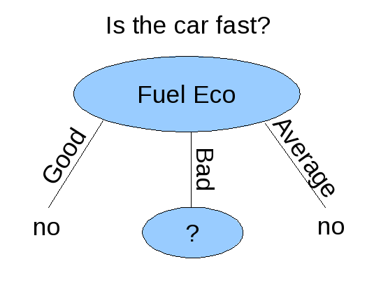
Example – Root of Decision Tree

Slide 27
Analogical Reasoning
Analogy making is a highly sophisticated cognitive process in which two conceptualizations - a source and a target - are analyzed for common structural patterns .
In analogies, source and target are typically of different domains (for metaphors this is even essential).
The purpose of analogies is to adapt knowledge available about the source conceptualization such that it can be applied to the target in a way that new analogous inferences can be drawn.
Analogy making requires intelligence since analogous patterns and transfers often are not obvious and depend on a certain conceptualization of the domains.
Eg : This company is like a racehorse. It's run fast and won the race, and now it needs feed and rest for a while.

Slide 28
Explanation Based Learning
Explanation-based learning (EBL) is a form of machine learning that exploits a very strong, or even perfect, domain theory to make generalizations or form concepts from training examples.

Slide 29
An example of EBL using a perfect domain theory is a program that learns to play chess by being shown examples.
domain theory is perfect or complete if it contains, in principle, all information needed to decide any question about the domain.
For example, the domain theory for chess is simply the rules of chess. Knowing the rules, in principle it is possible to deduce the best move in any situation

Slide 30
EBL software takes four inputs:
a hypothesis space (the set of all possible conclusions)
a domain theory (axioms about a domain of interest)
training examples (specific facts that rule out some possible hypotheses)
Operationality criteria (criteria for determining which features in the domain are efficiently recognizable, e.g. which features are directly detectable using sensors)

Slide 31
Inductive Learning
This involves the process of learning by example -- where a system tries to induce a general rule from a set of observed instances.
This involves classification -- assigning, to a particular input, the name of a class to which it belongs. Classification is important to many problem solving tasks.
A learning system has to be capable of evolving its own class descriptions.
The task of constructing class definitions is called induction or concept learning

Slide 32
5 attributes
1. Computational model : mathematical, optimization and arithmetic
2.Type of Problem : classification, pattern recognition
3. Domain area : industrial, research and educational
4. Problem Domain : information, automation and management
5. Discipline : engineering, science, finance

Slide 33
Rules for selecting machine
RULE 1 :
IF computational model is heuristic/algorithmic
AND type is classification
AND domain is information
AND discipline is engineering
THEN the computing machine workstation is selected.
{7 rules like this}

Slide 34
Knowledge Acquisition Tools
1. ROGET
Directly interacts with expert to design and develop an expert system.
Assists an initial design and steps through development stage.

Slide 35
Steps for ROGET
1. Design :
Establishes conceptual structure.
Expert is exposed to several existing experts.
Job of expert is to identify components of KBS.
Mechanism for handling uncertainty is also devised.

Slide 36
2. Evidence Category :
find or collect all observed phenomenon which the problem covers such as identification of tests, signs and symptoms, classification and analysis.

Slide 37
3. Assembly and revision:
Factors are assembled to structure KBS.
Knowledge is translated by ROGET to rule based system.

Slide 38
MOLE
Was developed by Eshelman and McDermott(1988) as a KA tool for classification type of problems having heuristic knowledge.
Data and its interpretation, explanation and categorization are done and then different steps are involved to determine and select the best.

Slide 39
Designing of Mole
KB development :
Mole transforms the covering of raw knowledge concerning the cause and effect relationship between a symptom and hypothesis.
Application :
Utilized for fault diagnosis in automobile components of car engines.

