Slide 1
Unit - 5
ETL: Transformations and Other Operators

Slide 2
Store Mapping
In the Design Center, we will right-click on the Mappings node of the ACME_DW_PROJECT | Databases | Oracle | ACME_DW_LOCATION database and select New.... Enter STORE_MAP for the name of the mapping and a blank Mapping Editor window will open.

Slide 3
Adding source and target operators
The target for this mapping is STORE dimension, drag this dimension from Databases | Oracle | ACME_DW_LOCATION | Dimensions onto the mapping and drop it to the right of the POS_TRANS_STAGE table operator.

Slide 4
STORE DIMENSION Attributes
NAME
STORE_NUMBER
ADDRESS1
ADDRESS2
STATE
ZIP_POSTALCODE
COUNTRY
REGION_NAME

Slide 5
For the REGION level, attributes are:
NAME
DESCRIPTION
COUNTRY_NAME

Slide 6
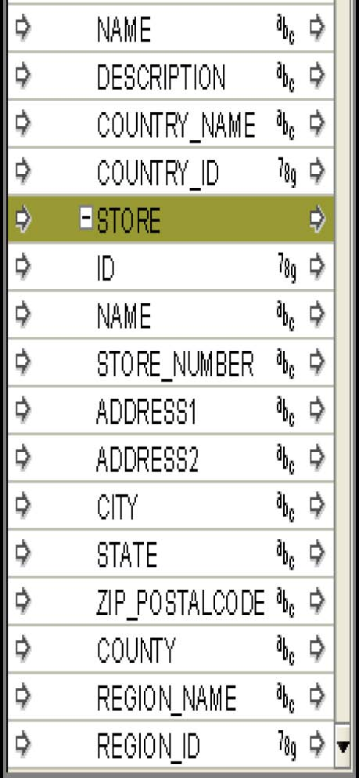

Slide 7
Populate the STORE dimension :
STORE_NAME
STORE_NUMBER
STORE_ADDRESS1
STORE_ADDRESS2
STORE_CITY
STORE_STATE
STORE_ZIPPOSTALCODE
STORE_REGION
STORE_COUNTRY

Slide 8
Map into the corresponding attributes in the dimension in the STORE group.
STORE_NAME to NAME
STORE_NUMBER to STORE_NUMBER
STORE_ADDRESS1 to ADDRESS1
STORE_ADDRESS2 to ADDRESS2
STORE_CITY to CITY
STORE_STATE to STATE
STORE_ZIPPOSTALCODE to ZIP_POSTALCODE
STORE_REGION to REGION_NAME

Slide 9
Transformations Required
STORE_NAME, STORE_NUMBER: trim spaces and change these attributes to uppercase to facilitate queries as they are part of the business identifier
STORE_ADDRESS1, ADDRESS2, CITY, STATE, and ZIP_POSTALCODE: trim spaces and change the STATE attribute to uppercase
STORE_REGION: trim spaces and change this attribute to uppercase.

Slide 10
Adding Transformation Operators
Add Transformation Operator from the Design Center.
There are two options : select from existing repository which is bounded and next which is unbounded.
select the first option.
search the TRIM() function from list of existing functions.

Slide 11
TRIM Transformation Operator window will appear on mapping.
TRIM operator has one input attribute and one output attribute.
The input attribute is the string we want to trim the whitespace from and the output attribute represents the result of applying the TRIM operator to the input string.

Slide 12
drag another Transformation Operator UPPER transformation for STORE_NAME and STATE
drop it to the right of the TRIM operator in mapping.

Slide 13
The following attributes of the POS_TRANS_STAGE mapping table operator will provide the input for the five TRIM operators:

Slide 14
STORE_ADDRESS1
STORE_ADDRESS2
STORE_CITY
STORE_STATE
STORE_ZIPPOSTALCODE

Slide 15
The output of the TRIM operators will be connected directly to attributes of the STORE dimension as follows:
ADDRESS1
ADDRESS2
CITY
ZIP_POSTALCODE

Slide 16
The TRIM output for the STORE_STATE attribute will be connected to the UPPER Transformation Operator.
The output from the UPPER operator will be connected to the STATE attribute in the STORE dimension.

Slide 17
Transformations
Region Level
STORE_REGION to NAME in the REGION level using TRIM and UPPER transformations
STORE_REGION to DESCRIPTION in the REGION level using a TRIM transformation
STORE_COUNTRY to COUNTRY_NAME in the REGION level using TRIM and UPPER transformations.
Country Level
STORE_COUNTRY to NAME in the COUNTRY level using TRIM and UPPER transformations
STORE_COUNTRY to DESCRIPTION in the COUNTRY level using a TRIM transformation

Slide 18
two more Transformation Operators into our mapping—TRIM and UPPER—and map the STORE_REGION to the TRIM, the TRIM to the UPPER, and the UPPER to the REGION_NAME field.

Slide 19
Using Key Lookup Operator
This operator will be used to for country attribute in STORE dimension.
It will work only on tables , so the first step is to create a country table.

Slide 20
Creating external table
in the Design Center Navigate to PE |ACME_DW_PROJECT|Databases|Oracle | ACME_DW_LOCATION| External Tables node right click and select New.
This will launch the External Table wizard

Slide 21
Step 1 : Welcome screen will appear give the external table name as “Countries” and click NEXT
Step 2 : In files module give the name “Countries.csv” and click NEXT
Step 3 : Select the default location for the external table (ACME_FILES_LOCATION) and summary screen will appear. Click Finish

Slide 22
Creating and Loading a Lookup Table
Step 1 : Right-click on the Mappings node, select New..., enter COUNTRIES_LOOKUP_MAP in the name field, and click on the OK button.
STEP 2 : In the Mapping Editor , drag an External Table Operator from the Palette window onto the mapping.
STEP 3 : On the Add External Table Operator Countries , Countries External Table is available ADD that table.

Slide 23
Step 4: Drag the Table operator.
Step 5: Click on Create and Bind in OWB table node.
Step 6 : Click OK , a table in created inside the table node and the operator is binded to it.
STEP 7 : Navigate to ACME_DW_LOCATION | Tables | Countries_Lookup

Slide 24
To add Constraints
In the Design Center, open the COUNTIES_LOOKUP table in the Data Object Editor by double-clicking on it under the Tables node.
Click on the Constraints tab.
Click on the Add Constraint button.
Type PK_COUNTIES_LOOKUP in the Name column.
In the Type column, click on the drop-down menu and select Primary Key.
Click on the Local Columns column, and then click on the Add Local Column button.
Click on the drop-down menu that appears and select the ID column.
Close Data Object Editor.

Slide 25
Retrieving the key to use for a Lookup Operator
The STORE_NUMBER data element contained in the STORES source table has a code that indicates the county the store is located in for stores in the USA.
It contains three to six numbers.
This number is actually the ID number found in the counties.csv flat file, and which is the ID in the lookup table and it is the Lookup key.

Slide 26
Adding a SUBSTR Transformation Operator
The Transformation Operators available to us in OWB include a SUBSTR (or substring) transformation that will extract the county ID value out of the STORE_NUMBER field.
The SUBSTR transformation takes three parameters—the string we want to extract the substring from, a number indicating the start position of the substring within the string, and a number indicating the length of the substring to extract.

Slide 27
drag a Transformation Operator onto the STORE_MAP mapping between the POS_TRANS_STAGE table and the STORE dimension.
Add Transformation Operator pop-up window appears, select the SUBSTR() transformation.

Slide 28
Adding a Constant operator
drag a Constant operator onto the mapping to the left of the SUBSTR Transformation Operator.
The Constant operator has only output attribute.
To add an attribute, click on the Add button.
Create an output attribute “position” and data type Number.

Slide 29
Create an output attribute “length” and data type Number.
Add the output attributes.
Connect the constants with SUBSTR operator.

Slide 30
Adding a TO_NUMBER transformation
drag a Transformation Operator onto our mapping to the right of the SUBSTR operator and select TO_NUMBER from the resulting pop up.
This operator needs three parameters, only one of which is absolutely necessary—the expression to convert to a number. The other two parameters are optional
Drag a line from the VALUE attribute of SUBSTR to the EXPR input attribute of the TO_NUMBER operator.

Slide 31
Add a Key Lookup Operator
drag a Key Lookup operator onto the mapping and drop it to the right of the TO_NUMBER operator.
1. KEY_LOOKUP Wizard is launched with Welcome Screen. It has a default name of KEY_LOOKUP. change it to COUNTRIES_LOOKUP and click on the Next

Slide 32
2. Give one input operator INGRP1 and one output operator OUTGRP1. Click NEXT
3. Specify the return value of TO_NUMBER operator. Click Next.
4. Specify the object to lookup the value.
5. The object can be table, view, dimension or cube.
6. We will select the LOOKUP table COUNTRIES_LOOKUP.

Slide 33
7. Specify ID as LOOKUP_TABLE_KEY.
8. Click NEXT and Summary screen will appear. Click Finish.
9. Connect Country_Name to KeyLookup operator.
(We are Done with STORE dimension Mapping)

Slide 34
PRODUCT mapping
Drag the POS_TRANS_STAGE table from the Explorer window and drop it on the left of the mapping, and drag the PRODUCT dimension from ACME_DW_LOCATION| Dimensions and drop it to the right of the mapping.

Slide 35
Transformations & Mappings
PRODUCT_NAME to NAME (in the ITEM level)—needs trimmed spaces and conversion to uppercase
PRODUCT_NAME to DESCRIPTION (in the ITEM level)—needs trimmed spaces
PRODUCT_SKU to SKU—needs trimmed spaces and conversion to uppercase
PRODUCT_PRICE to LIST_PRICE—no transformation needed
PRODUCT_BRAND to BRAND_NAME—needs trimmed spaces and conversion to uppercase.

Slide 36
For the BRAND level transformations :
PRODUCT_BRAND to NAME (in the BRAND level)—needs trimmed spaces and conversion to uppercase
PRODUCT_BRAND to DESCRIPTION (in the BRAND level)—needs trimmed spaces
PRODUCT_CATEGORY to CATEGORY_NAME—needs trimmed spaces and conversion to uppercase

